Slide 1
Thermal spatial heterogeneity and coral bleaching: implications for habitat refuges
R Bhagooli & N Taleb-Hossenkhan
Department of Biosciences, Faculty of Science, University of Mauritius, Reduit, Mauritius

Slide 2
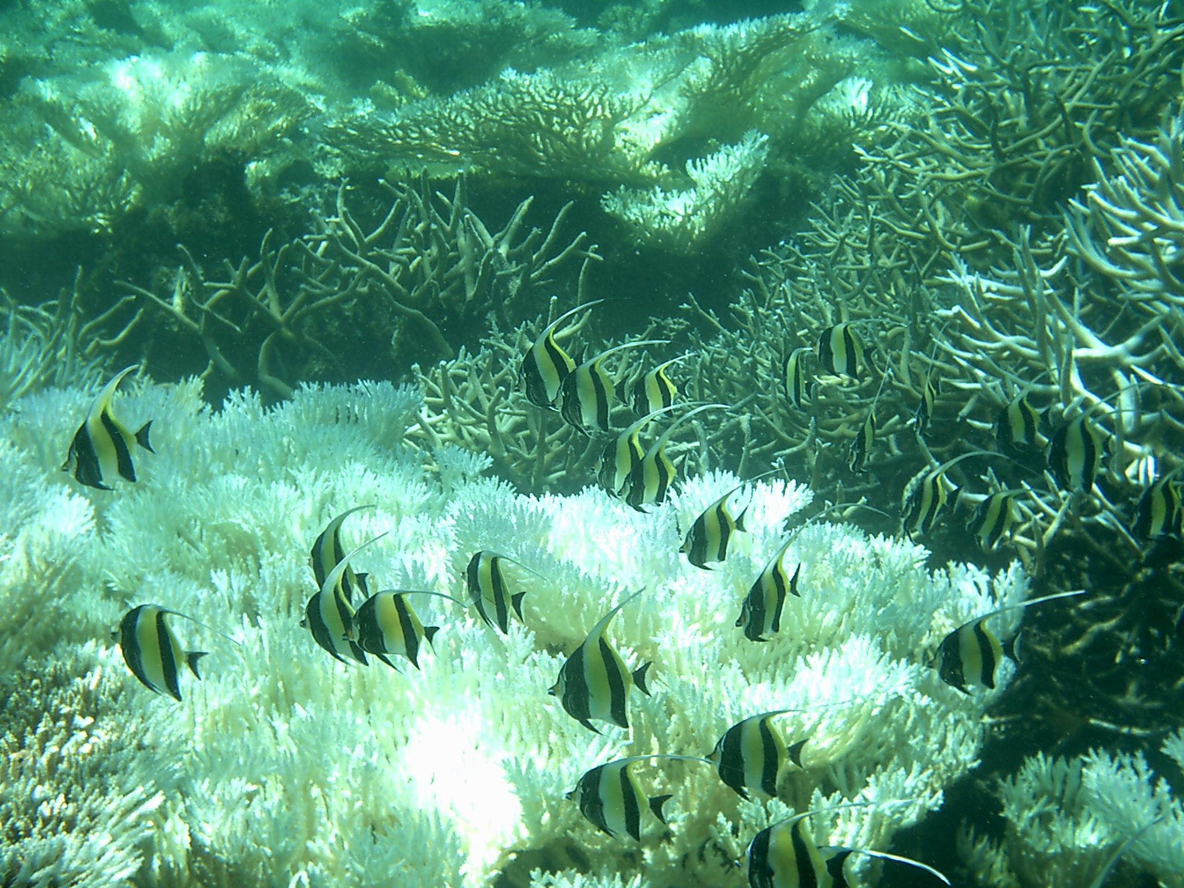
Coral Bleaching = Disassociation
(Release/Degradation)

Slide 3
Background
In 2009, intra-specific and inter-specific differential bleaching/mortality were exhibited by reef-building corals in Mauritius due to a thermal anomaly event (Bhagooli & Sheppard 2012).
Variable bleaching/mortality have been quite well -documented both through field -based observations (Marshall & Baird 2000, Spencer et al. 2000, Loya et al. 2001) and laboratory-based experiments (Warner et al 1996, Bhagooli & Yakovleva 2004 ).

Slide 4
Background (cont’d)
Several explanations:
Biological:
Different coral growth rates (Brown and Suharsono 1990)
Differences in heat dissipation capacities in PSII o f zooxanthellae (Warner et al. 1996)
Genetic constitution of the symbiotic algae (Rowan et al. 1997); zooxanthellae clades/ITS types (Rowan 2004, Sampayo et al. 2008, Bhagooli 2009, 2010 )
Preferential survival o f thick-tissued species (massive corals) and shape dependent differences in colony mass –transfer efficiency (Loya et al. 2001)
Differences in tolerance among the hosts (Brown et al. 2002, Bhagooli & Hidaka 2003, Baird et al. 2009)
Environmental:
Variability in light regimes (Brown et al. 2002)
Variability in thermal environment (Nadaoka et al. 2001a)
Hydrodynamic/water flow variability in the surrounding environment (Nadaoka et al. 2001b, Nakamura 2003)

Slide 5
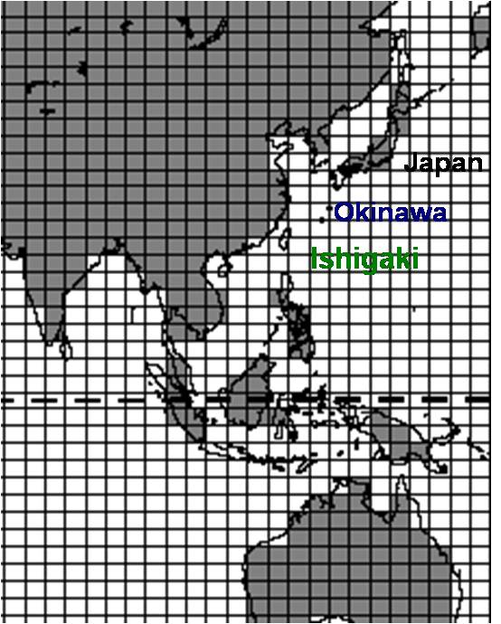
Background (cont’d)
  Generalisations:
  Snapshot temperature recording
  Single data logger
  Satellite data (resolution-km)
  Cells/grids?
However, to date spatial variation in seawater temperature within reefs at a finer scale and bleaching occurrences, including intra-specific differential bleaching vulnerabilities, remain uncharted in the Mauritian waters.

Slide 6
Aim
  Quantify and compare seawater temperature variations and bleaching of Acropora muricata within and across two coral reefs sites
Methodology
  Deploy underwater temperature and light data loggers and monitor seawater temperature variations within (near coast, lagoon & reef stations) and across two coral reefs sites: Flic-en-Flac & Belle Mare for 2010-2011.
  Conduct coral bleaching surveys (bleached A. muricata colonies out of 30 at each station) at the two sites.

Slide 7
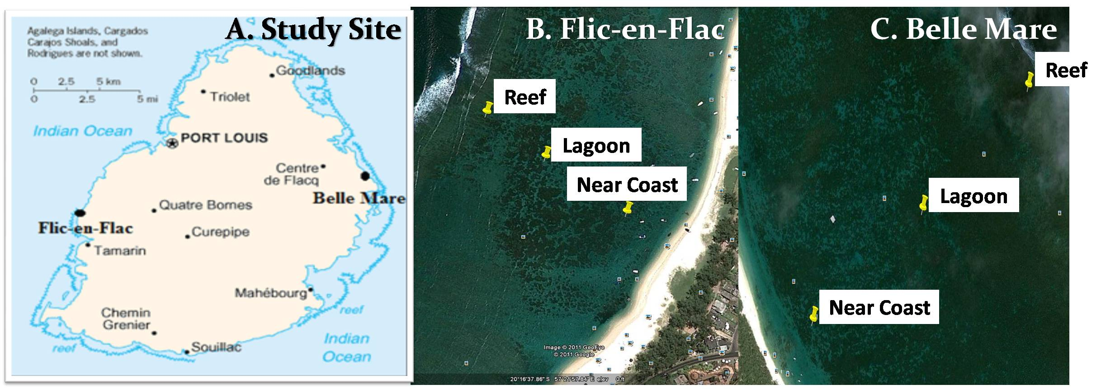
Study Sites
Map of Mauritius (Source: Exotic Mauritius, 2005 - 2012) indicating study sites, Flic-en-Flac (FEF) and Belle Mare (BM) (A), the representative transects and stations (Source: Google Earth) at FEF (B) and BM (C). Station 1 (S1) = Near coast; Station 2 (S2) = Lagoon; and Station 3 (S3) = Reef.

Slide 8
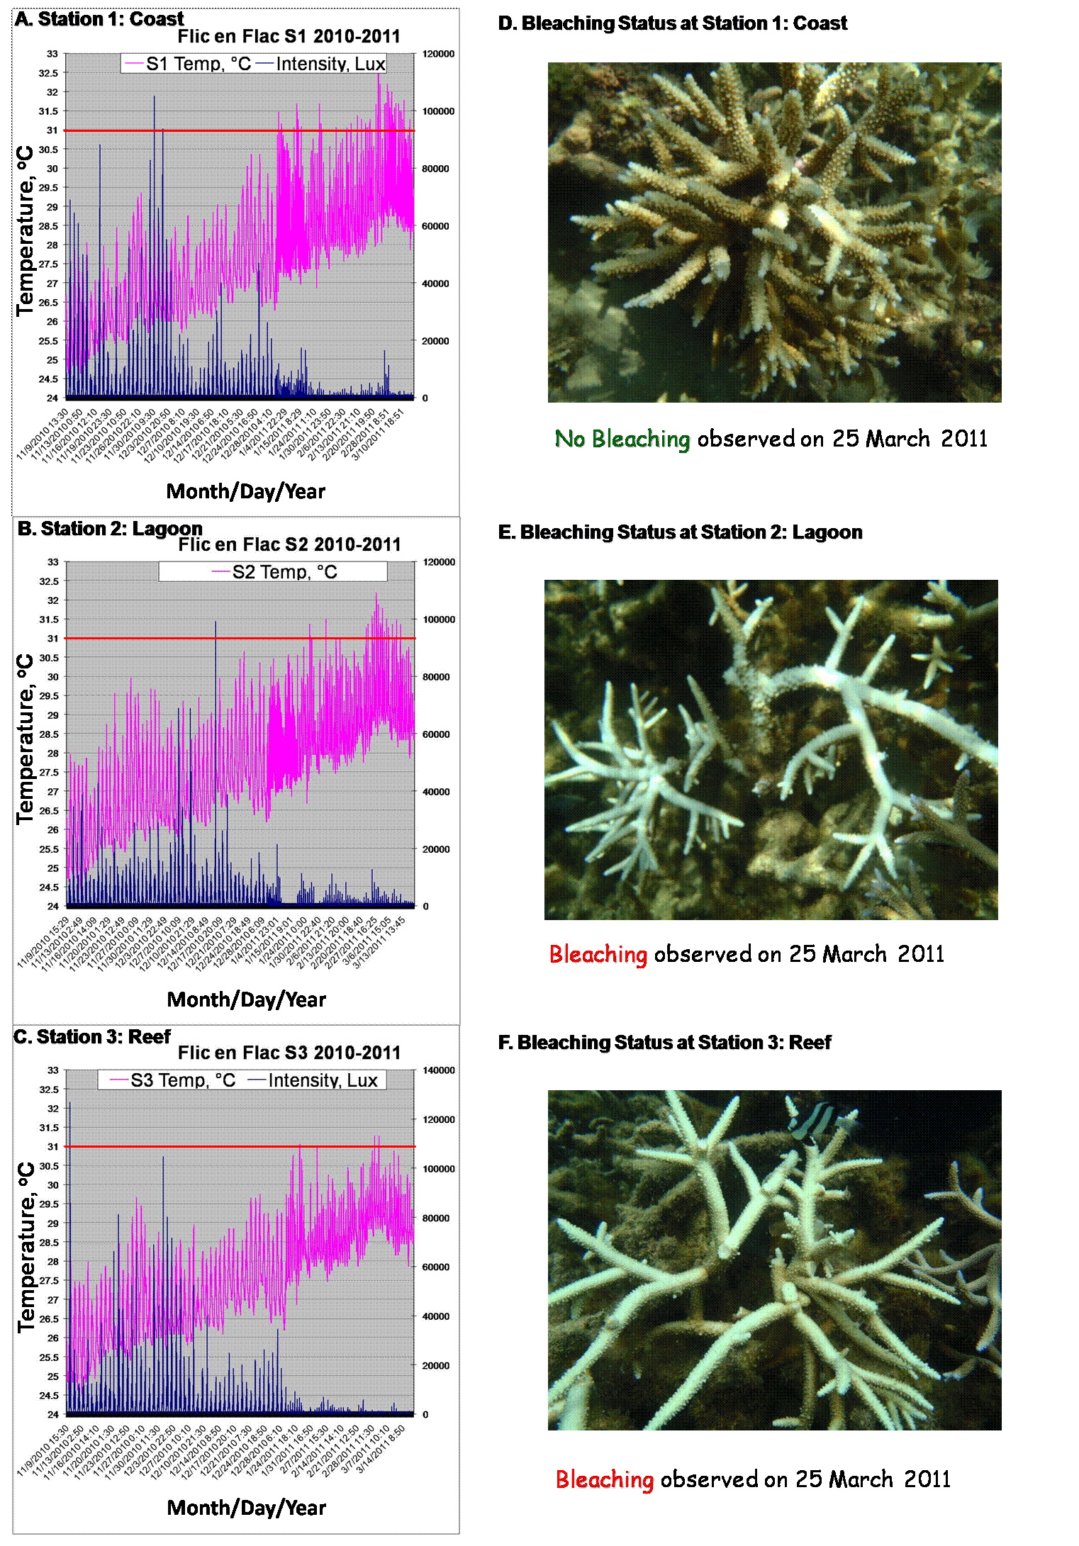
Flic-en-Flac
Results

Slide 9
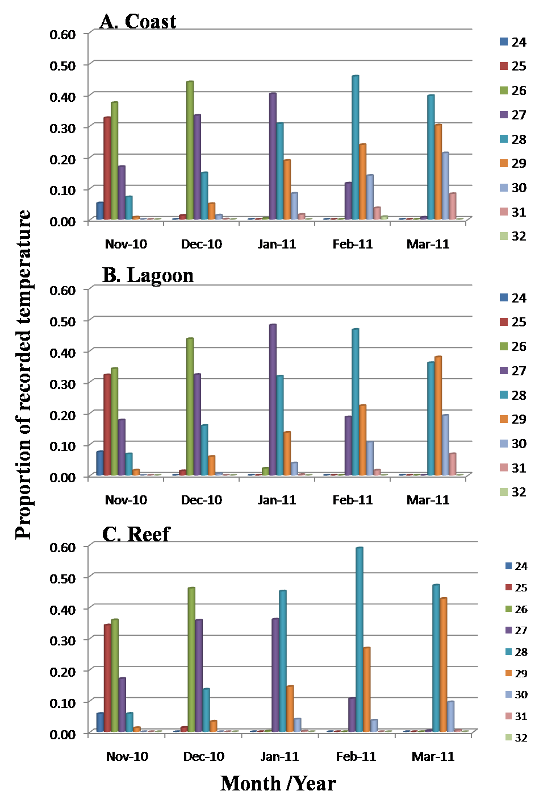
Flic-en-Flac
Results

Slide 10
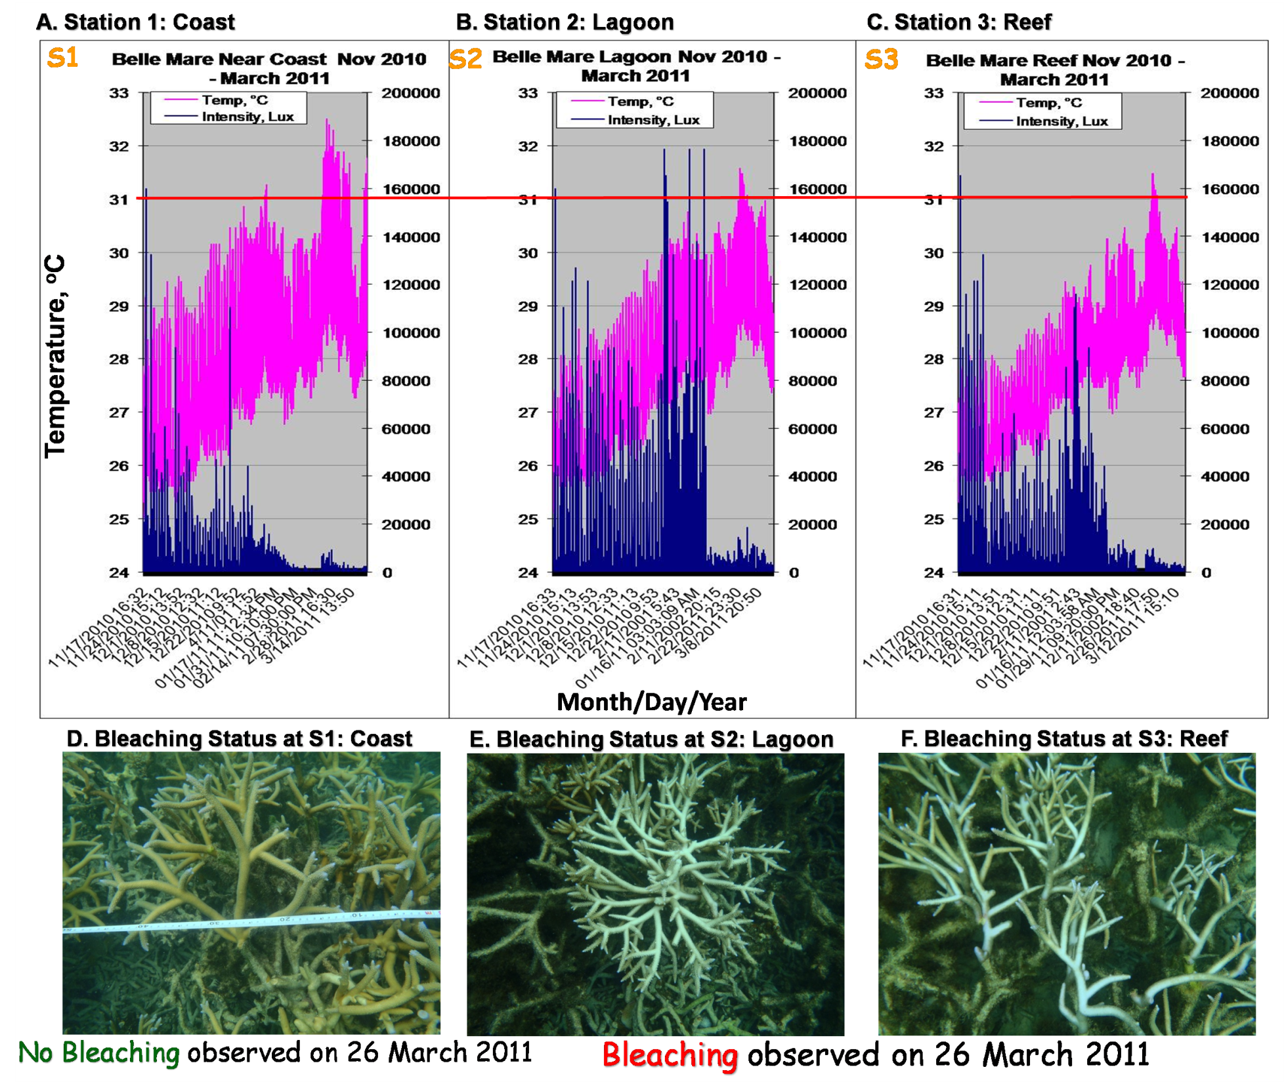
Results
Belle Mare

Slide 11
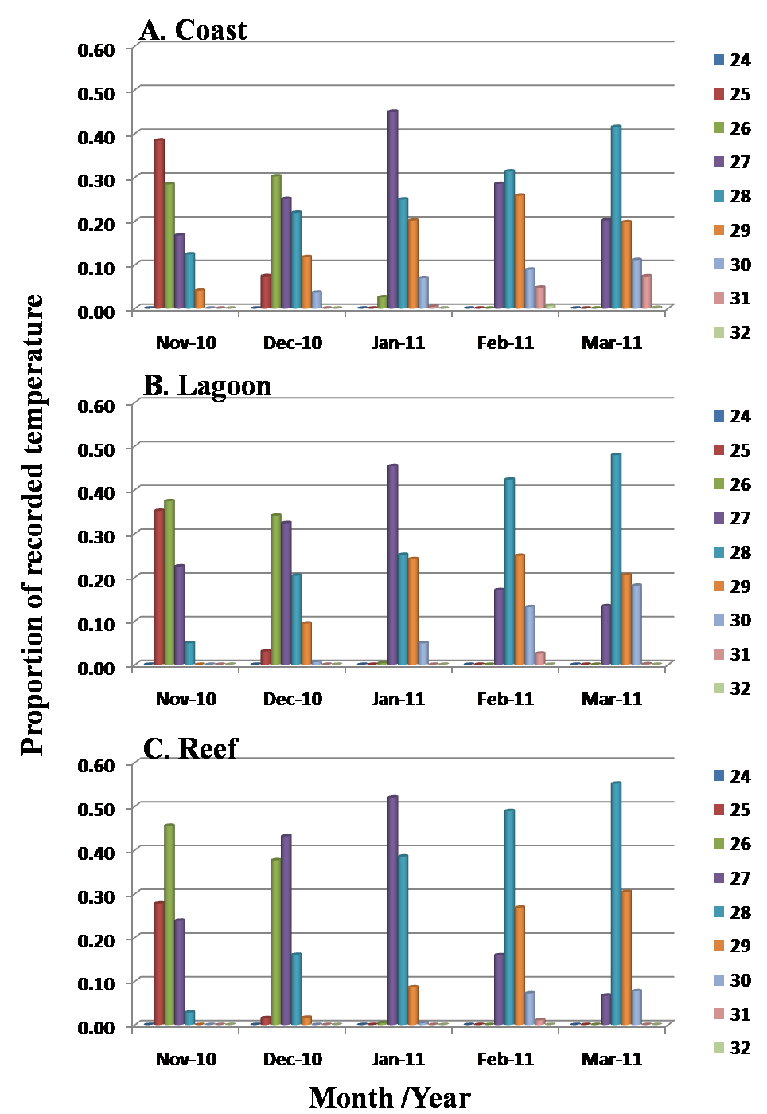
Results
Belle Mare

Slide 12
Multiple comparison of mean ranks for all stations following Kruskal-Wallis ANOVA test by ranks analyses of temperature and light at two sites (BM and FEF) with three stations (coast-S1, lagoon-S2, reef-S3) at each site and time of the year (Nov and Dec 2010, and Jan, Feb and March 2011). **P < 0.01 and ***P < 0.001.
 |  | Temp |  |  | Light
Flic-en-Flac | Station | S1 | S2 | S3 | S1 | S2 | S3
 | S1 | - | *** | ** | - | ** | NS
 | S2 | *** | - | NS | ** | - | NS
 | S3 | ** | NS | - | NS | NS | -
Belle Mare | S1 | - | *** | *** | - | *** | ***
 | S2 | *** | - | *** | *** | - | ***
 | S3 | *** | *** | - | *** | *** | -

Slide 13
3-Way ANOVA analyses of percentage of bleached colonies at two sites (BM and FEF) with three stations (coast-S1, lagoon-S2, reef flat-S3) at each site and time of the year (Nov and Dec 2010 and Jan, Feb and March 2011). Asterisks represent significant difference **P < 0.01 and ***P < 0.001.
Source of Variation | SS | df | MS | F | P
Site | 0.05 | 1 | 0.05 | 24.44 | ***
Station | 4.14 | 2 | 0.07 | 1062.91 | ***
Time | 3.01 | 4 | 0.75 | 386.78 | ***
Site*Station | 0.03 | 2 | 0.01 | 6.46 | **
Site*Time | 0.06 | 4 | 0.02 | 8.25 | ***
Station*Time | 1.69 | 8 | 0.21 | 108.19 | ***
Site*Station*Time | 0.05 | 8 | 0.01 | 3.34 | **

Slide 14
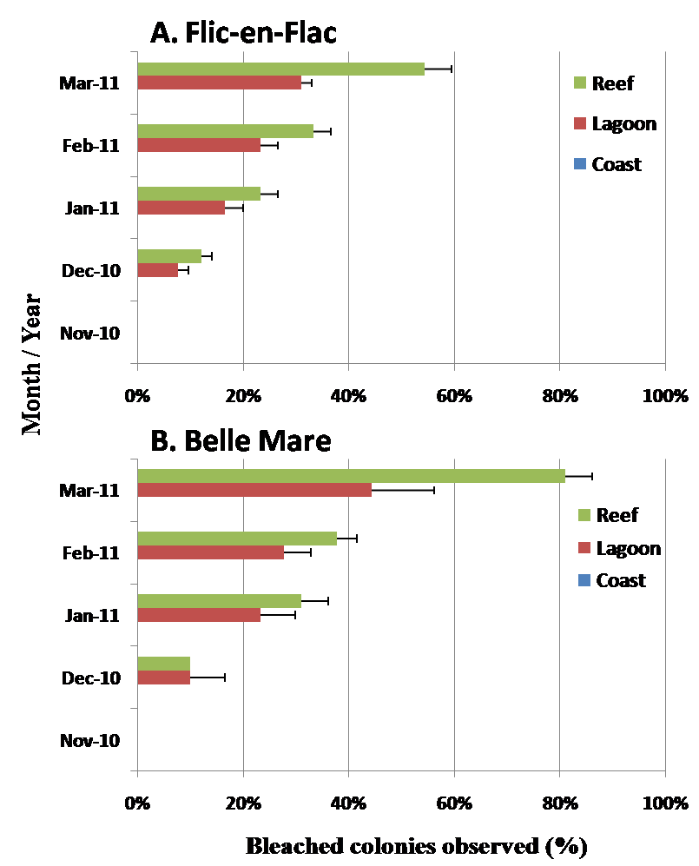
Bleaching (percentage colonies bleached out of 30 observed ones) in A. muricata from November 2010 till March 2011 at three stations (coast-S1, lagoon-S2, reef flat-S3) at FEF (A) and BM (B).

Slide 15
Main Findings
Temperatures at the near coast stations were higher and increased faster over time than those in the lagoon and the reefs.
Coral colonies of A. muricata occurring near the coast at both studied sites did not bleach.

Slide 16
Plausible Explanations
Biological:
Acclimation through gradual higher temperature exposures near the coast.
‘Adaptation’ through harbouring of more thermally robust microalgal endosymbiotic photosynthetic dinoflagellates and/or thermally more robust host genotypes.
Availability of more nutrients/zooplankton
Environmental:
Variation in hydrodynamics/water flow
Turbidity

Slide 17
Conclusions
Spatial thermal heterogeneity within a reef at two sites was demonstrated.
Acropora muricata colonies near the coast did not bleach though temperatures were higher than at other stations and thus might be thermally more robust.
Near the coast areas can act as refuges for this coral species and anthropogenic impacts have to be minimal to protect these thermally robust colonies of A. muricata.
Future work could focus on mechanisms of thermo-tolerance in this coral species and the potential use in active rehabilitation of damaged reefs.

Slide 18
Acknowledgement
The University of Mauritius for financial and logistic support.
Technical staff of the Environmental Science laboratory.
Students:
  Nadeem Nazurally
  Shamimtaz Sadally
  Sujata Ramkissoon
  Arvind Gopeechund

Slide 19

Thank you!
Questions?

